Slide 1


Catch "The Russian Spies" Challenge
National Research Nuclear University MEPhI
Solved by students:
Volyanskiy Julian,
Ivanova Nina,
Khudoyarova Anastasia,
Nikolaeva Elizabeth

Slide 2

Discovery
Data sources:
BoardingData.csv
FrequentFlyerForum-Profiles.json
PointzAggregator-AirlinesData.xml
Sirena-export-fixed.tab
Skyteam_Timetable.pdf
SkyTeam-Exchange.yaml
YourBoardingPassDotAero.zip

Slide 3


Discovery
Spy search criteria:
Changes travel class frequently
Does not have a meal during the flight
Travels without luggage
Travels frequently to different countries

Slide 4
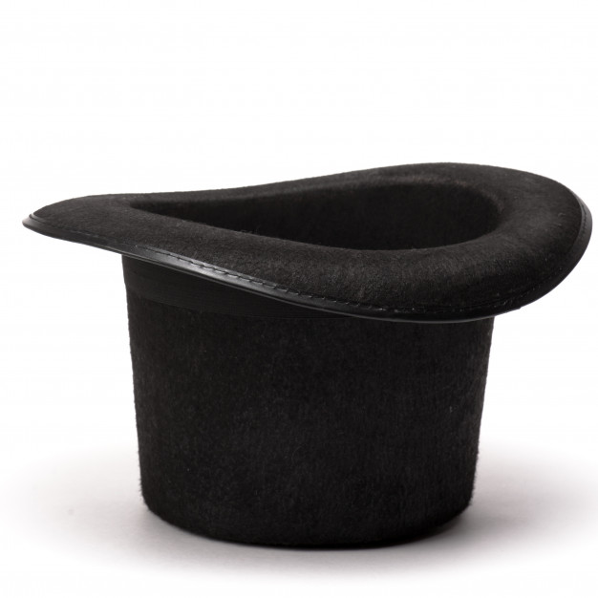

Data Preparation
File:
.csv
.tab
.xml
.json
.xlsx
.yaml
.pdf
Method or Tool:
remove empty line
LibreOffice Calc
Java
Python
Python
Python
Adobe reader, Kotlin
.csv
parsers

Slide 5
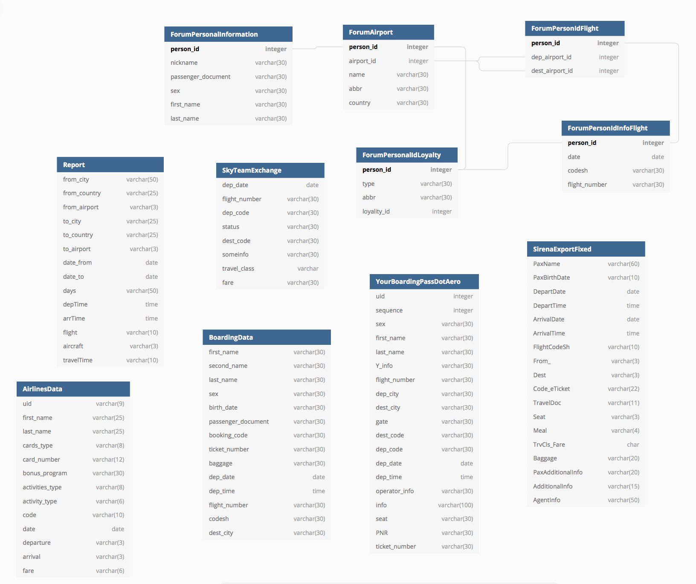
Model
planning
Result table
id serial
first_name varchar(30)
last_name varchar(30)
birth_date varchar(30)
passenger_document varchar(30)
travel_class varchar(30)
food_info varchar(30)
dep_city varchar(30)
dest_city varchar(30)
dep_date date
baggage varchar(30)

Slide 6



Model Building: Preparation
Estimates are developed for each passenger
according to spy search criteria
Total number of flights is counted
Passenger route tracking algorithm is created: number of circle and collapsed routes is counted
Minimum threshold of class turnover has been determined
Passenger’s meal requirement is estimated
Passenger’s baggage presence is determined

Slide 7
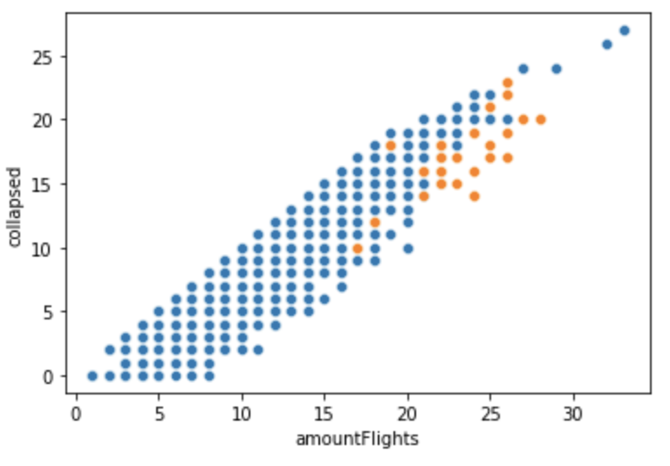
Model Building: Analysis
IsolationForest algorithm is used for anomaly detection
Pairwise distribution
of the number of
suspicious and normal routes:

Slide 8
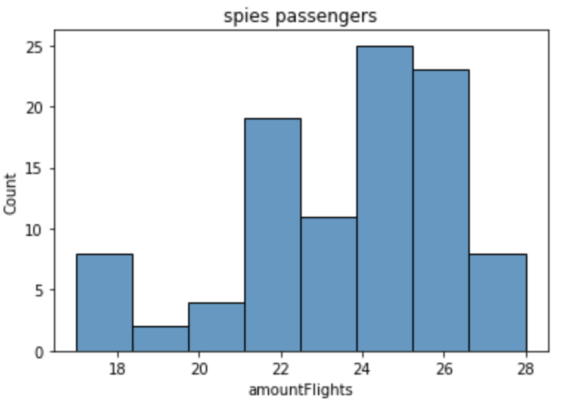
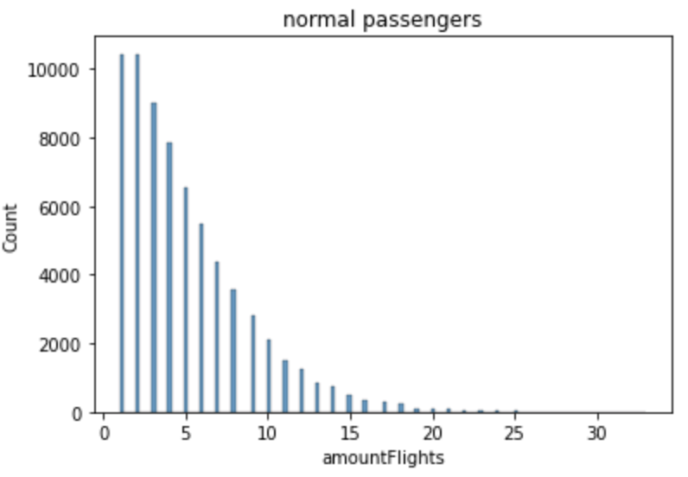
Model Building: Analysis
Normal and spies passengers distributions are determined:

Slide 9
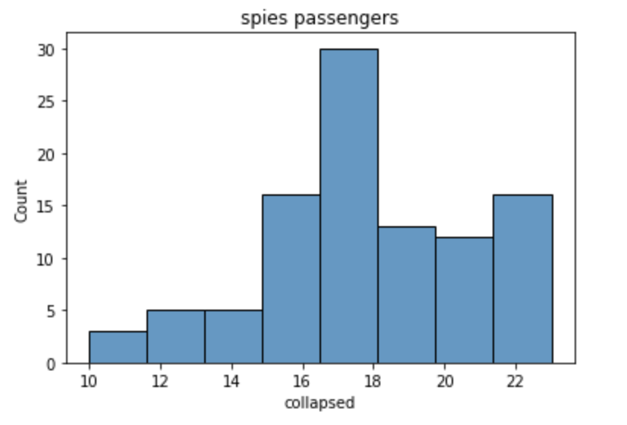
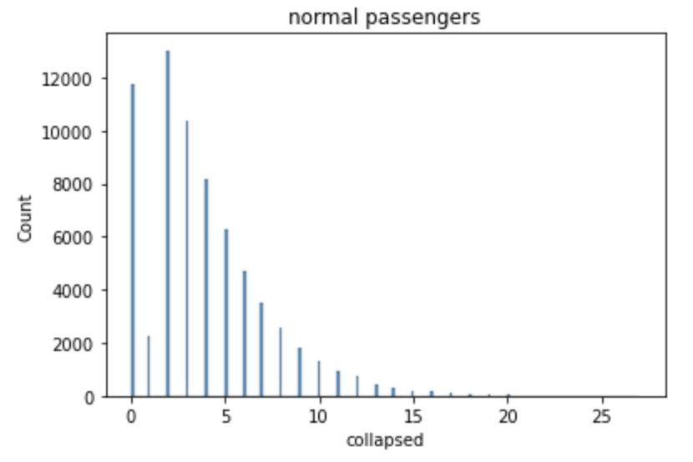
Model Building: Analysis
Normal and spies passengers distributions are determined amongst collapsed routs:

Slide 10

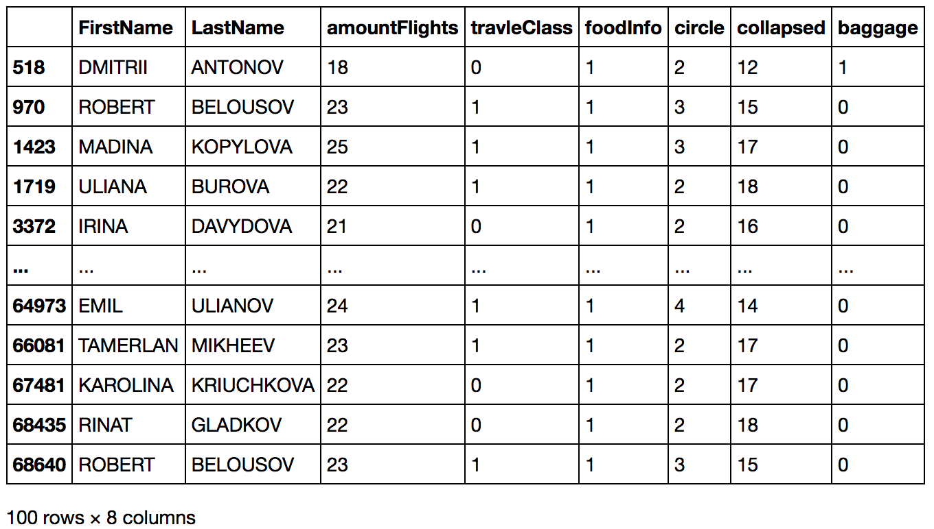

Model Building: Results
List of caught spies:

